Slide 1


Supporting the implementation of Core20PLUS5
Click for narration

Slide 2

Introduction
Click for narration
CORE20PLUS5 is an NHS England and NHS Improvement (NHSESI) approach developed by the Healthcare Inequalities Improvement Team to support NHS Integrated Care Systems (ICSs) to reduce health inequalities. 5 clinical areas have been identified for accelerated improvement: Maternity, Severe Mental Illness, Chronic Respiratory Disease, Early Cancer Diagnosis and Hypertension Case-Finding. Lipid optimal management and smoking cessation are recent inclusions. All of these areas are all underpinned by NICE guidance.
We have collated the key evidence-based recommendations aligned to each of the 5 clinical areas and additions, and practical tools and resources to support improvements in these areas.
Also included is NICE guidance on general approaches that are shown to help reduce health inequalities, for example community engagement, shared decision making and behaviour change.

Slide 3



NICE’s unique role in addressing health inequalities
Click for narration
Tackling health inequalities is in our DNA
NICE is seen as a leader in evidence excellence
Partners look to NICE for evidenced approaches to address health inequalities
3

Slide 4
NHS planning guidance 2022 to 2023: tackling health inequalities
Click for narration
Restore NHS services inclusively
Mitigate against digital exclusion
Ensure datasets are complete and timely
Accelerate preventative programmes that proactively engage those at greatest risk of poor health outcomes
Strengthen leadership and accountability
“Integrated Care Systems will take a lead role in tackling health inequalities, building on the CORE20PLUS5 approach to support the reduction of health inequalities experienced by adults, children and young people”.

Slide 5
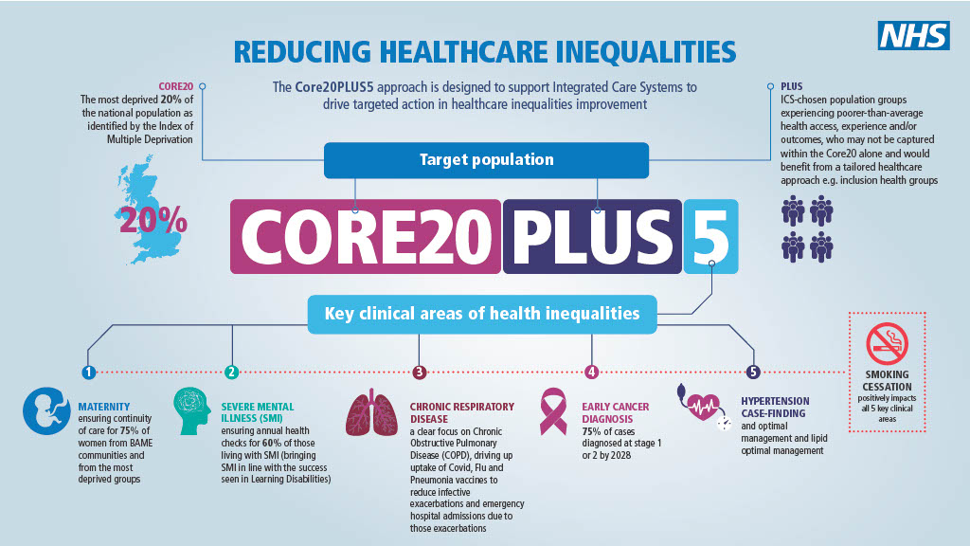
Click for narration

Slide 6
NICE guidance

Slide 7


NICE guidance – helping to reduce the gap
Click for narration
Equitable implementation of NICE recommendations ensures that the care you provide is effective, makes efficient use of resources, and reduces inequalities and unwarranted variation.
We offer evidence-based recommendations on a wide range of topics. Including preventing and managing specific conditions, and interventions to improve the health of communities.
NICE guidance should support strategies that improve population health as a whole, while offering particular benefit to the most disadvantaged. This may mean making recommendations for specific groups of people.

Slide 8
NICE guidance mapped to Core20PLUS5
Click for narration
1. Maternity: continuity of care
Antenatal care (NG201) rec 1.1.12 - those responsible for planning and delivering antenatal services should aim to provide continuity of carer.
2. Severe mental illness (SMI): annual health checks
Bipolar disorder: assessment and management (CG185) rec 1.2.10-13; 1.3.2; 1.8.1-5 reference what should be included in a physical health check for people with SMI, performed at least annually.
3. Chronic respiratory disease: vaccine uptake
Flu vaccinations: increasing uptake (NG103).
4. Early cancer diagnosis
Suspected cancer: recognition and referral (NG12) – all recommendations are applicable to and support early diagnosis.
5. Hypertension case finding
Cardiovascular disease: identifying and supporting people most at risk of dying early (PH15) rec 1 and 2 – includes opportunistic engagement.

Slide 9
NICE guidance mapped to Core20PLUS5
Click for narration
Lipid optimal management
Cardiovascular disease (CVD): risk assessment and reduction, including lipid modification (CG181) rec 1.3.14 Before offering statin treatment for primary prevention, discuss the benefits of lifestyle modification and optimise the management of all other modifiable CVD risk factors if possible.
NICE endorsed resources include: NHSE Statin intolerance pathway and Lipid management national treatment algorithm and pathway.
Smoking cessation
Tobacco: preventing uptake, promoting quitting and treating dependence (NG209) brings together and updates all NICE's previous guidelines on using tobacco, including smokeless tobacco. It covers nicotine replacement therapy and e-cigarettes to help people stop smoking or reduce their harm from smoking.

Slide 10

NICE guidelines on approaches to addressing health inequalities
Click for narration
NG44/QS148 Community engagement: improving health and wellbeing and reducing health inequalities
NG197 Shared decision making
PH6 Behaviour change: general approaches
CG138 Patient experience in adult NHS services: improving the experience of care for people using adult NHS services
CG136 Service user experience in adult mental health: improving the experience of care for people using adult NHS mental health services
QS167 Promoting health and preventing premature mortality in black, Asian and other minority ethnic groups.
10

Slide 11
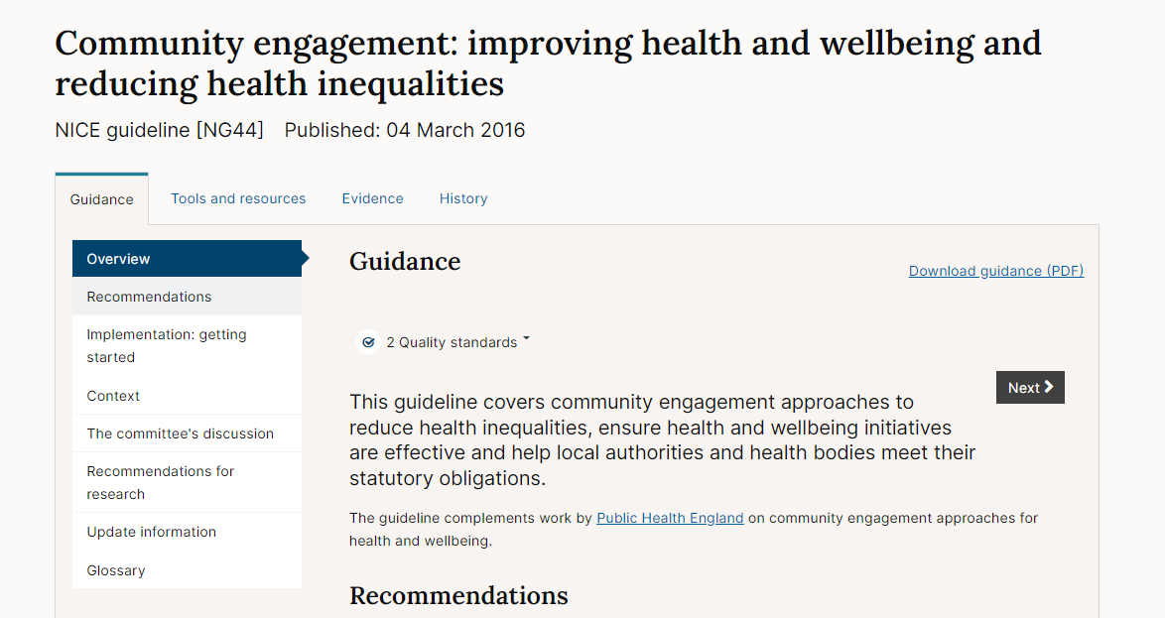
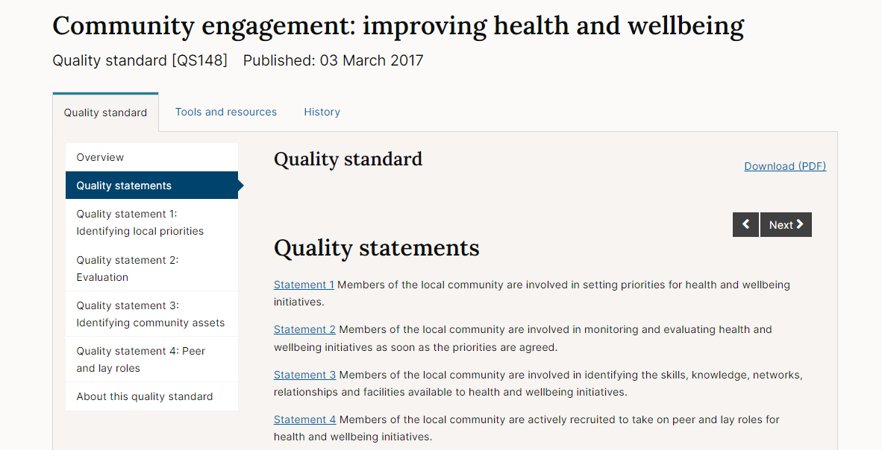
Examples of NICE guidelines

Slide 12

Shared decision making and health literacy
Click for narration
Our shared decision making guideline covers how to make shared decision making part of everyday care.
It includes recommendations on training, communicating risks, benefits and consequences, using decision aids, and how to embed shared decision making in organisational culture and practices.
Effective shared decision making improves health literacy by improving communication between professionals and patients, providing clear information and increasing patients’ knowledge.
Shared decision making has a greater impact on those with
lower health literacy or who are more disadvantaged
so can reduce health inequalities.
12

Slide 13
NICE quality standards

Slide 14
NICE quality standards
Click for narration
Set out priority areas for quality improvement.
Cover areas where there is variation in practice and/or outcomes.
Support a population health management approach by helping you to identify high impact interventions and areas of unwarranted variation.
Use quality standard measures to:
Audit access/uptake of an intervention, identify current gaps or differential access.
Monitor progress over time, to see whether changes are resulting in improvement.
Develop performance indicators for inclusion in local dashboards.
Includes a rationale with clear links to the underpinning evidence base - can be useful when making a case for change.
14

Slide 15
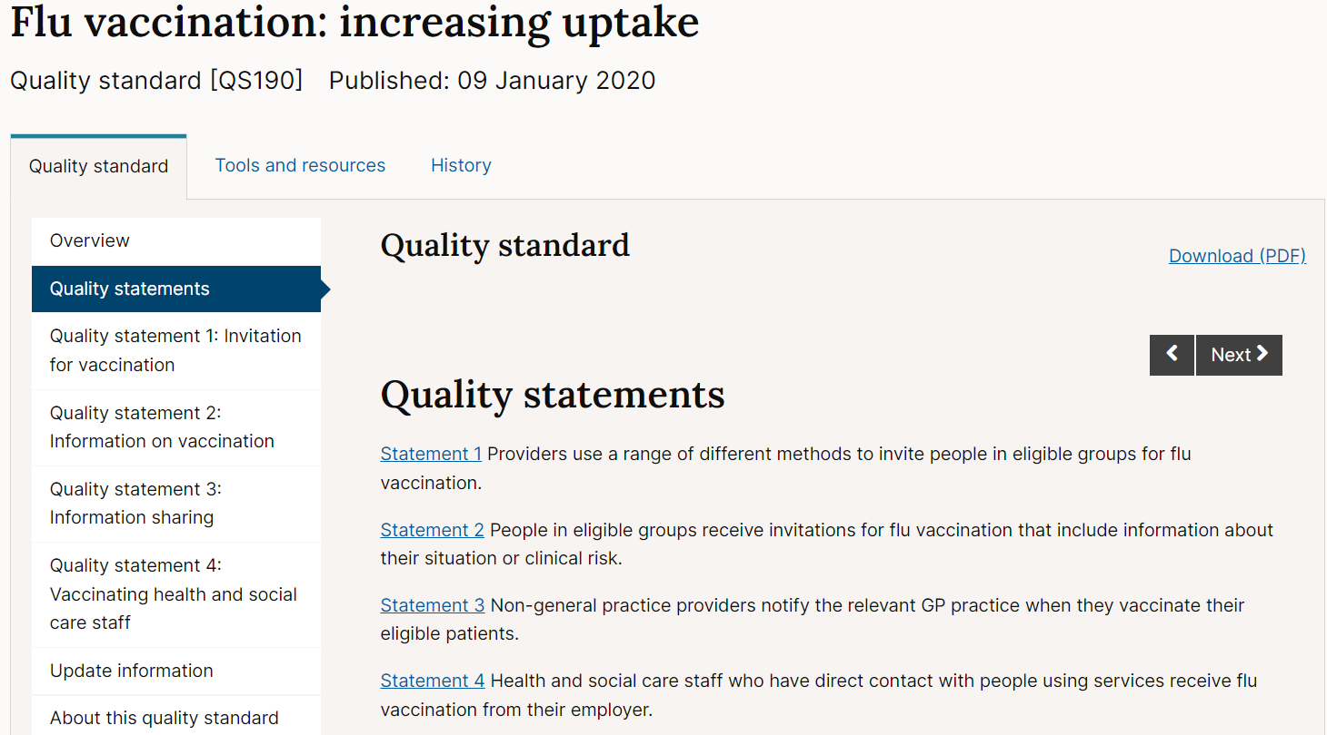
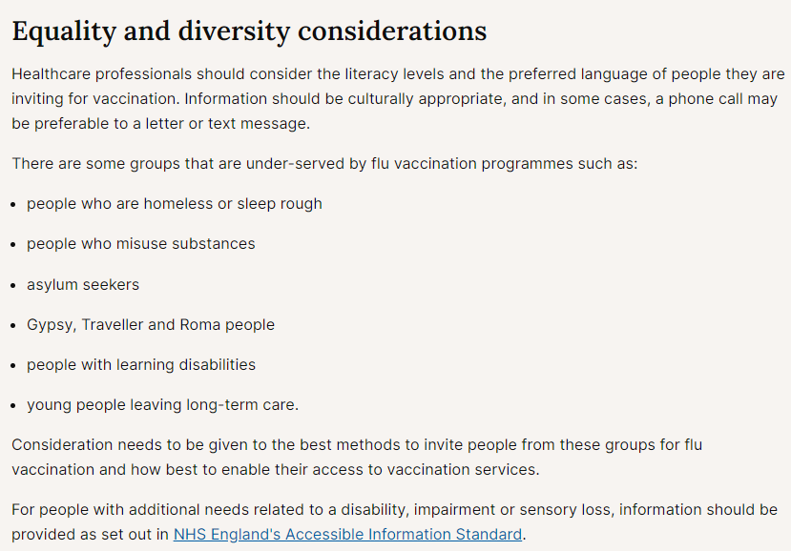
Examples of shared decision making

Slide 16
Practical tools and resources
Click for narration
shared learning examples
visual summaries
e-learning resources.

Slide 17
Pharmacist led hypertension review project in Black (African or African-Caribbean origin) patients – Hackney CCG
Click for narration
Background
Local data demonstrated that blood pressure was not as well controlled in Black (African or African-Caribbean origin) patients, compared to the rest of the population in City and Hackney CCG.
What did they do?
Trained pharmacists, who were not patient facing, to undertake a person-centred consultation and undertake hypertension review clinics in practice to help support patients to improve their blood pressure.
Used the NICE hypertension guideline, standards and medicines optimisation quality standard to design a protocol (covering Blood Pressure target, medication choice, medication adherence and lifestyle advice).
Invited patients for review based on criteria (underpinned by NICE) and then invited them for a follow up 1-3 months later.
Outcome
referrals to other services
changes to medication
uptake in lifestyle interventions
reduction in BP
improvement in medication adherence.
View the pharmacist led hypertension review project

Slide 18
Systematic case finding of people with hypertension – East Berkshire
Click for narration
Background
East Berkshire identified that there were a large number of people with undiagnosed hypertension within the region. In order to reach a diagnosis rate comparable to the best in England, a total of 13,069 people would need to be found and diagnosed.
What did they do?
The CCG Medicines Optimisation Team (MOT) developed a strategy to support practices in finding people who either had hypertension or were at risk of developing hypertension through systematic audit. Over 12 months, the audit was delivered in all 48 practices in East Berkshire. MOT Pharmacists then added people with hypertension to disease registers or referred people not yet diagnosed for diagnosis as set out in NICE guideline CG127 and QRISK assessment as set out in NICE guideline CG181.
Outcome
Total number of people added to hypertension register = 6,167.
All practices involved saw hypertension disease register increase
Percentage increase in number of people on hypertension register = 12.03%.
Provided a model for future working
View the Systematic case finding of people with hypertension case finding

Slide 19
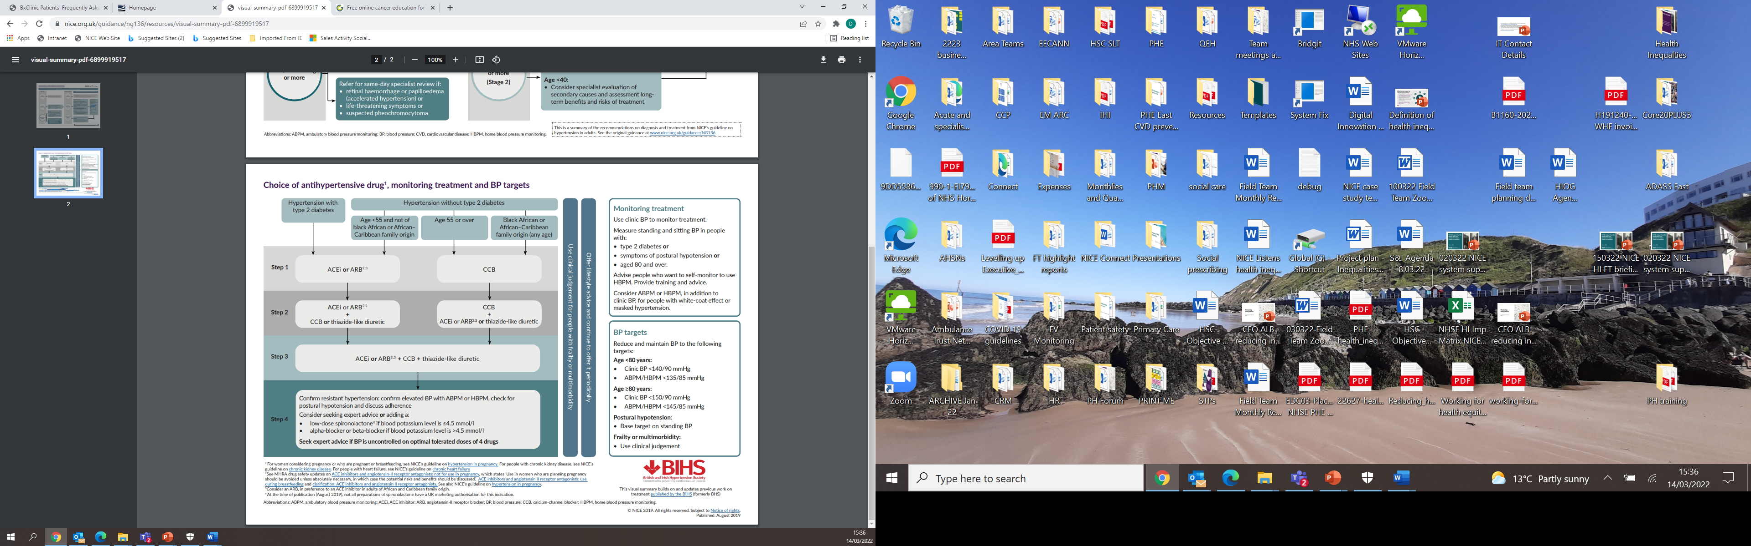
Example of a visual summary
Click for narration
19

Slide 20
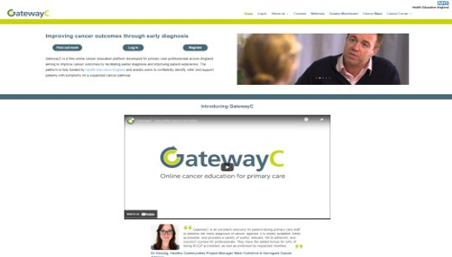
Example of an e-learning module
Click for narration
20

Slide 21
Thank you.
Please email: fieldteam@nice.org.uk to request a copy of the full resource
Staying up to date
follow us on Twitter @NICEcomms
NICE News - monthly e-newsletter
nice.org.uk
© NICE 2022. All rights reserved. Subject to notice of rights.

